Slide 1
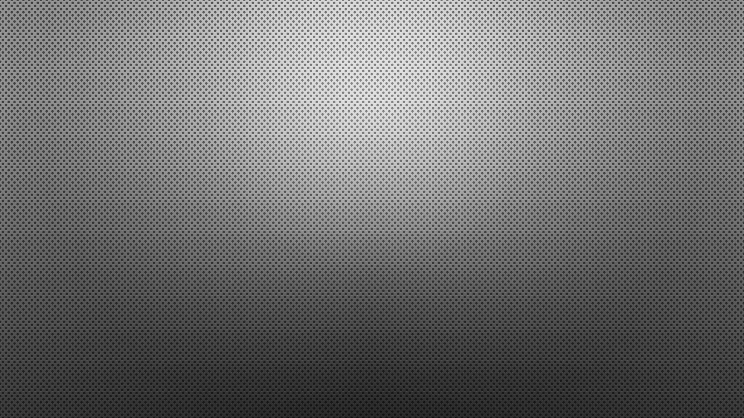
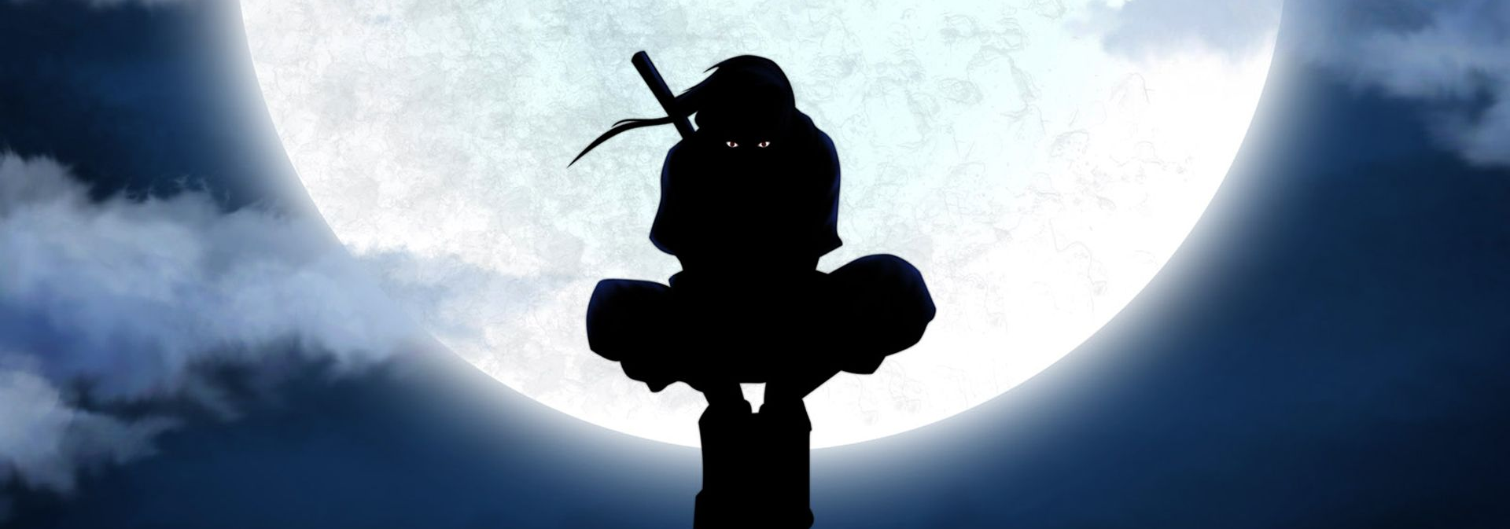
MARK Of The Ninja
Gauraang Goel
21CSU319

Slide 2
Table of Content
ABOUT
TOOLS
FEATURES
SCRIPTS
ASSETS
SPRITES
PROBLEMS FACED
GAMEPLAY

Slide 3
About
Shinju(Player) travels through the game's levels, he must use his skills to defeat numerous enemies, including soldiers, archers, and powerful boss(Final boss). He must also use his wit to find hidden paths and collect power-ups that will help him in his quest.
Visuals And music, feel of the game beautiful and every user will be easily hooked to the game and find it.
It will engage the user completely and have them attempting to get a higher score and Cross difficult levels.

Slide 4
Tools
The major softwares used are Unity, Visual Studio and Photoshop.
UI and aesthetics of the game were edited in photoshop and also taken from asset stores.
Coding and mechanics of the game were handled in Unity and Visual Studio.

Slide 5
Features
Left, right, jump, double jump
Power ups for speed and jump boost
Traps including spikes and Saws
Player Combat Animation
Two levels each with different challenges and terrain
UI for main menu, end menu
Player Health
Music and sound effects

Slide 6
Scripts
scripts in the game. They are as follows:
CameraController
PlayerMovement, CollectablesControl
EndMenu, StartMenu, Finish
StickyPlatform, WaypointFollower,TriggeredDeath
Healthbar, Health

Slide 7
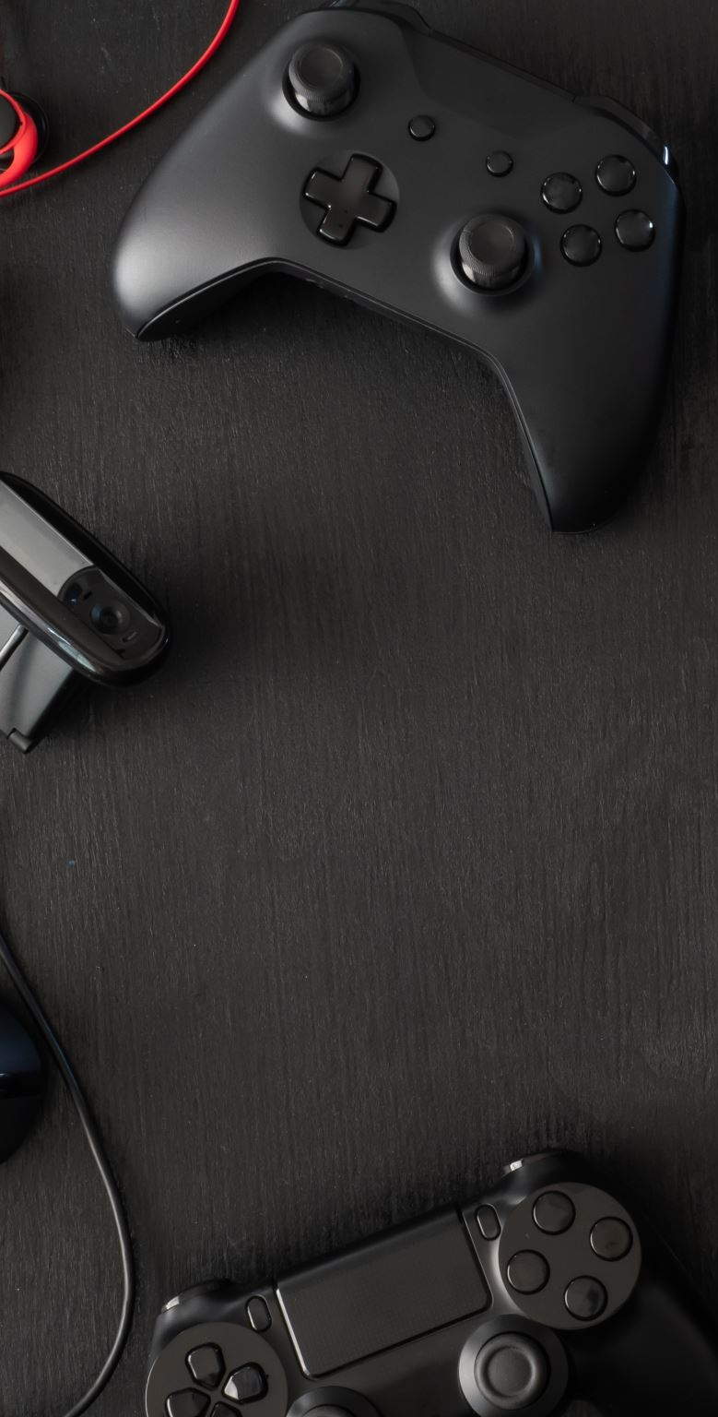
Assets
I used Several Assets in the Game:
Food Asset pack
Platforms Assets
Traps Sprites
Ninja Character pack
Casual Game Sounds
Weapons Asset Pack

Slide 8







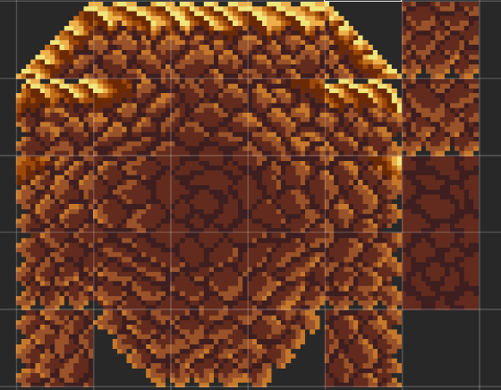
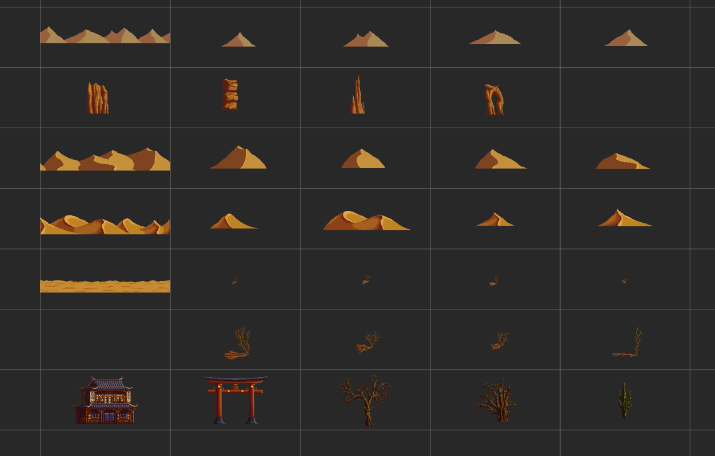
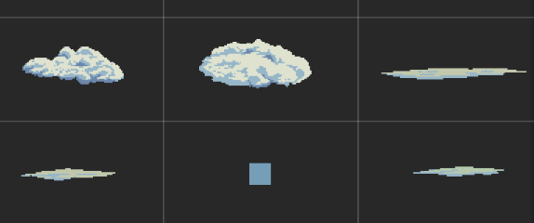
SPRITES USED

Slide 9
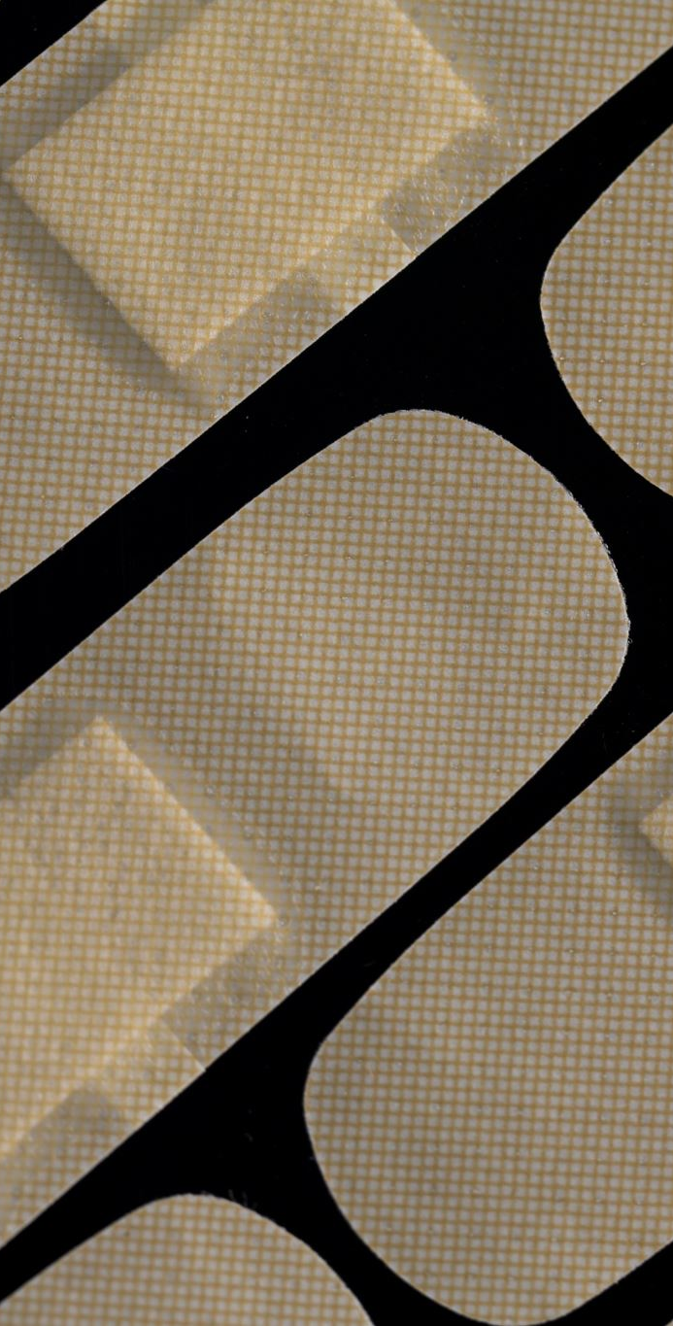
Problems Faced
Execution of the health bar in game.
Trouble making player combat and enemies health.
bugs caused by box colliders.

Slide 10
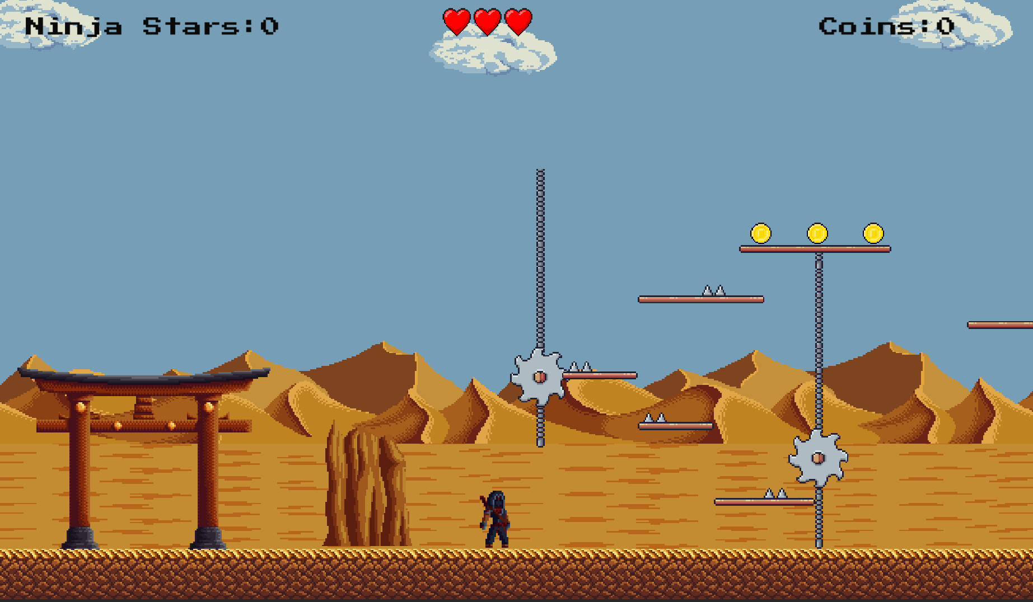
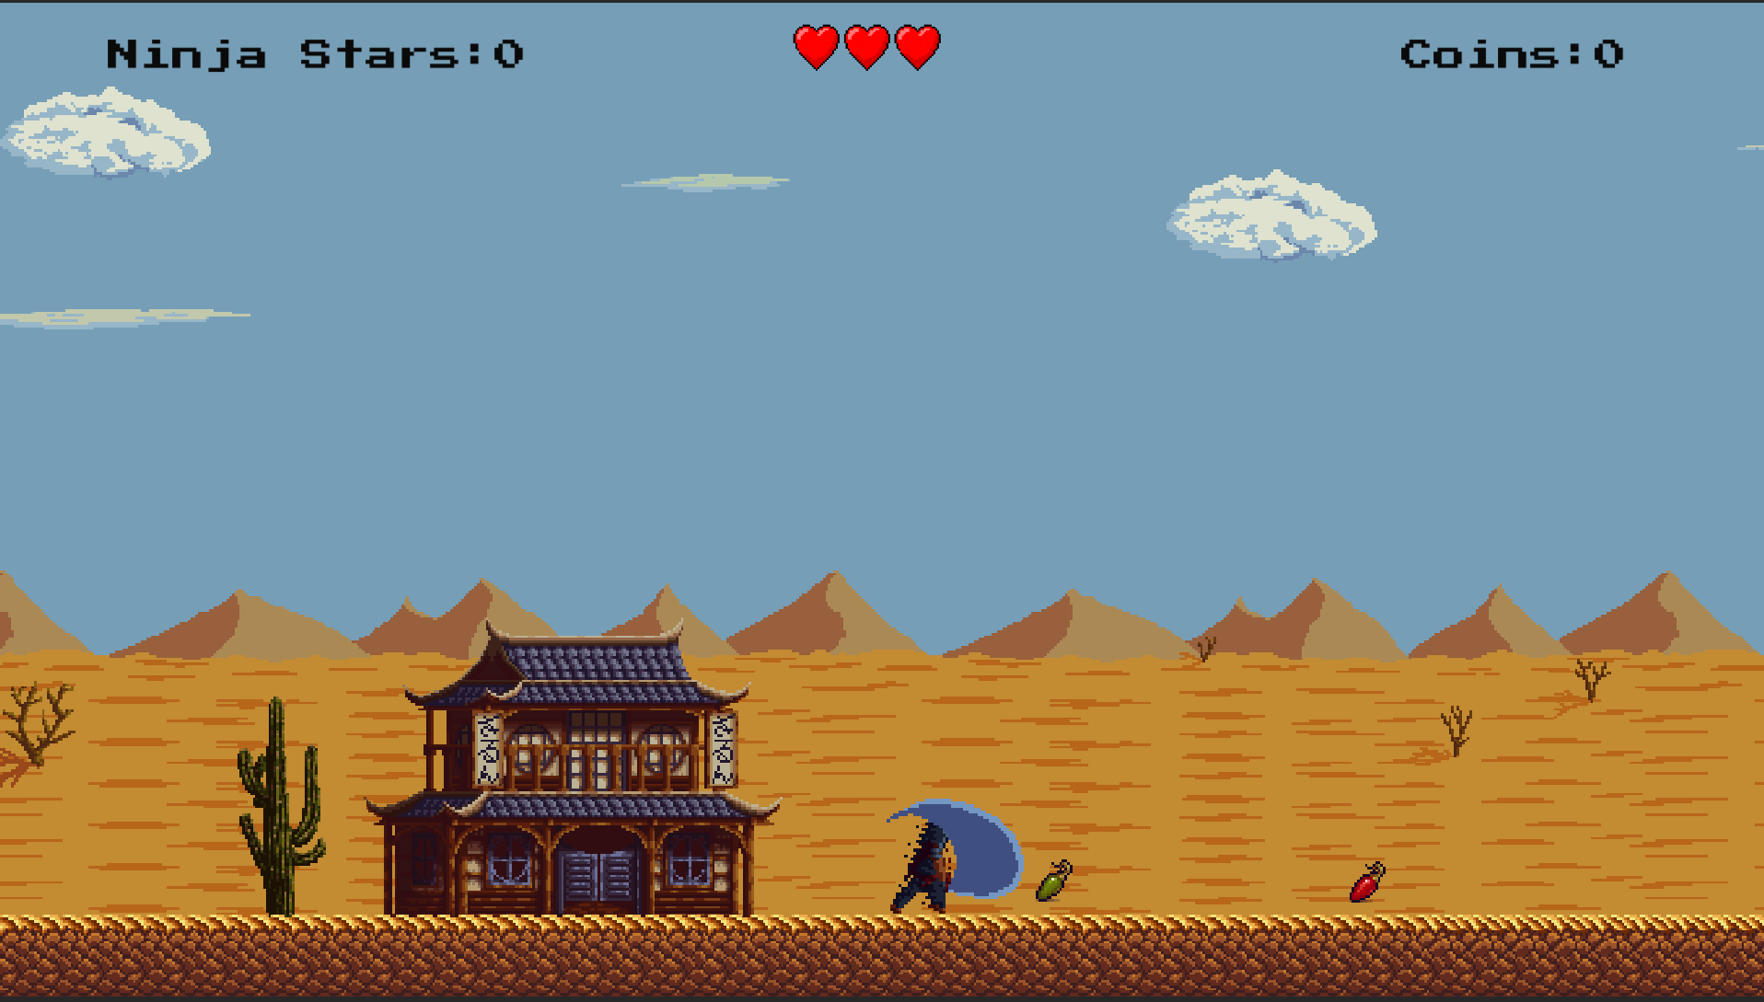
Gameplay SCREENSHOTS

Slide 11


